Slide 1




PDS
Containerization: Application Deployment
Computer Vision
https://github.com/siagianp
https://www.youtube.com/@AmelOline/videos
https://github.com/amelcharolinesgn2/Cloud-Infrastructures
https://github.com/amelcharolinesgn2/ClouD-Infrastructure-SISKA-2025
https://github.com/amelcharolinesgn2/CCNA1
https://github.com/amelcharolinesgn2/CCNA2
https://github.com/amelcharolinesgn2/AWS Certificate
Notes:
Lab Session 01: AWS Compute Foundations – EC2, Networking, and Application Deployment Lab Session 02: Identity and Access Control with IAM Lab Session 03: Cloud Storage Solutions – S3, EBS, and EFS Lab Session 04: Database Services – RDS, DynamoDB, and ElastiCache Lab Session 05: Load Balancing and Auto Scaling Lab Session 06: Container Orchestration with ECS, Fargate, and EKS Lab Session 07: Serverless Computing with Lambda Lab Session 08: Monitoring, Logging, and Security Auditing Lab Session 09: Infrastructure as Code – CloudFormation, CDK, and Terraform Lab Session 10: CI/CD Pipelines – App Runner, CodePipeline, GitHub Actions, and CodeDeploy Lab Session 11: AI/ML Services – Rekognition, Comprehend, Translate, and SageMaker Lab Session 12: Hybrid Cloud Networking – VPC Peering, Transit Gateway, VPN, and Direct Connect Lab Session 13: Security and Compliance – AWS Config, GuardDuty, Security Hub, and KMS Lab Session 14: Disaster Recovery and Business Continuity – AWS Backup, Multi-Region, and Failover Lab Session 15: Migration and Modernization – DataSync, DMS, MGN, Containers, and Serverless
Lab Session 16: Cost Management and Optimization – Cost Explorer, Trusted Advisor, Budgets, and Well-Architected
https://www.youtube.com/watch?v=SOTamWNgDKc&t=19604s

Slide 2
Containerization: Application Deployment
A comprehensive look at containerization technologies, benefits, and applications.

Slide 3
Product Manager:
Yes, but we are NOT goin
Developer:
Its works on my computer

Slide 4
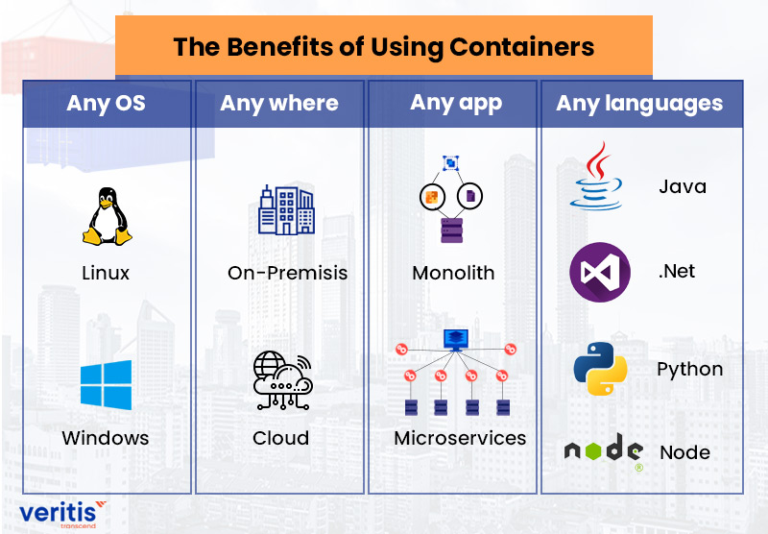

Slide 5
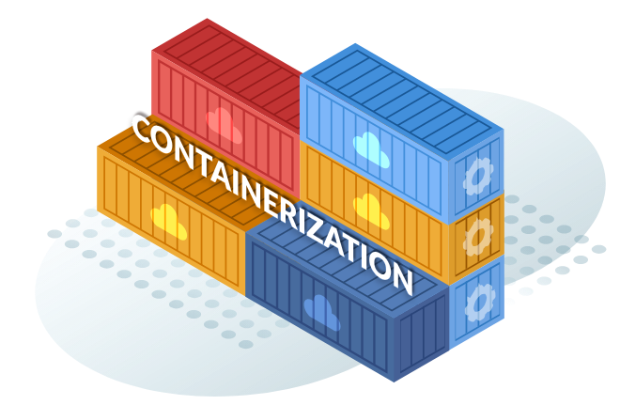
Introduction to Containerization
Containerization is a lightweight virtualization method where applications and their dependencies are packaged together into containers, ensuring consistency across environments.
Key Features:
Lightweight compared to virtual machines.
Portable and consistent.
Isolated environments for applications.

Slide 6
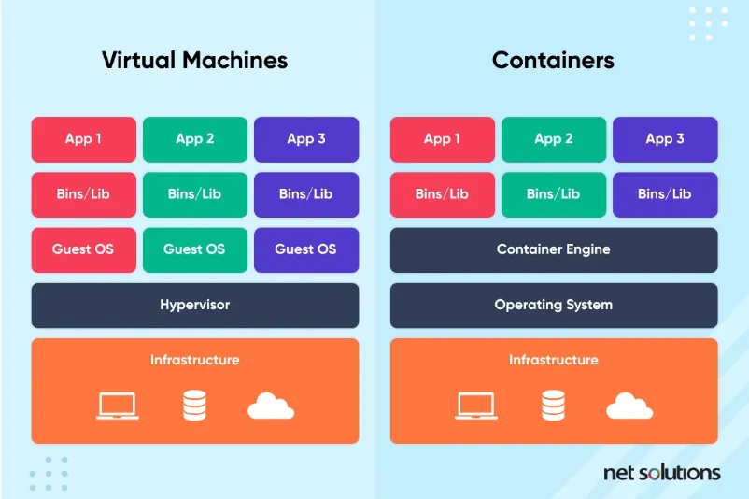

Slide 7
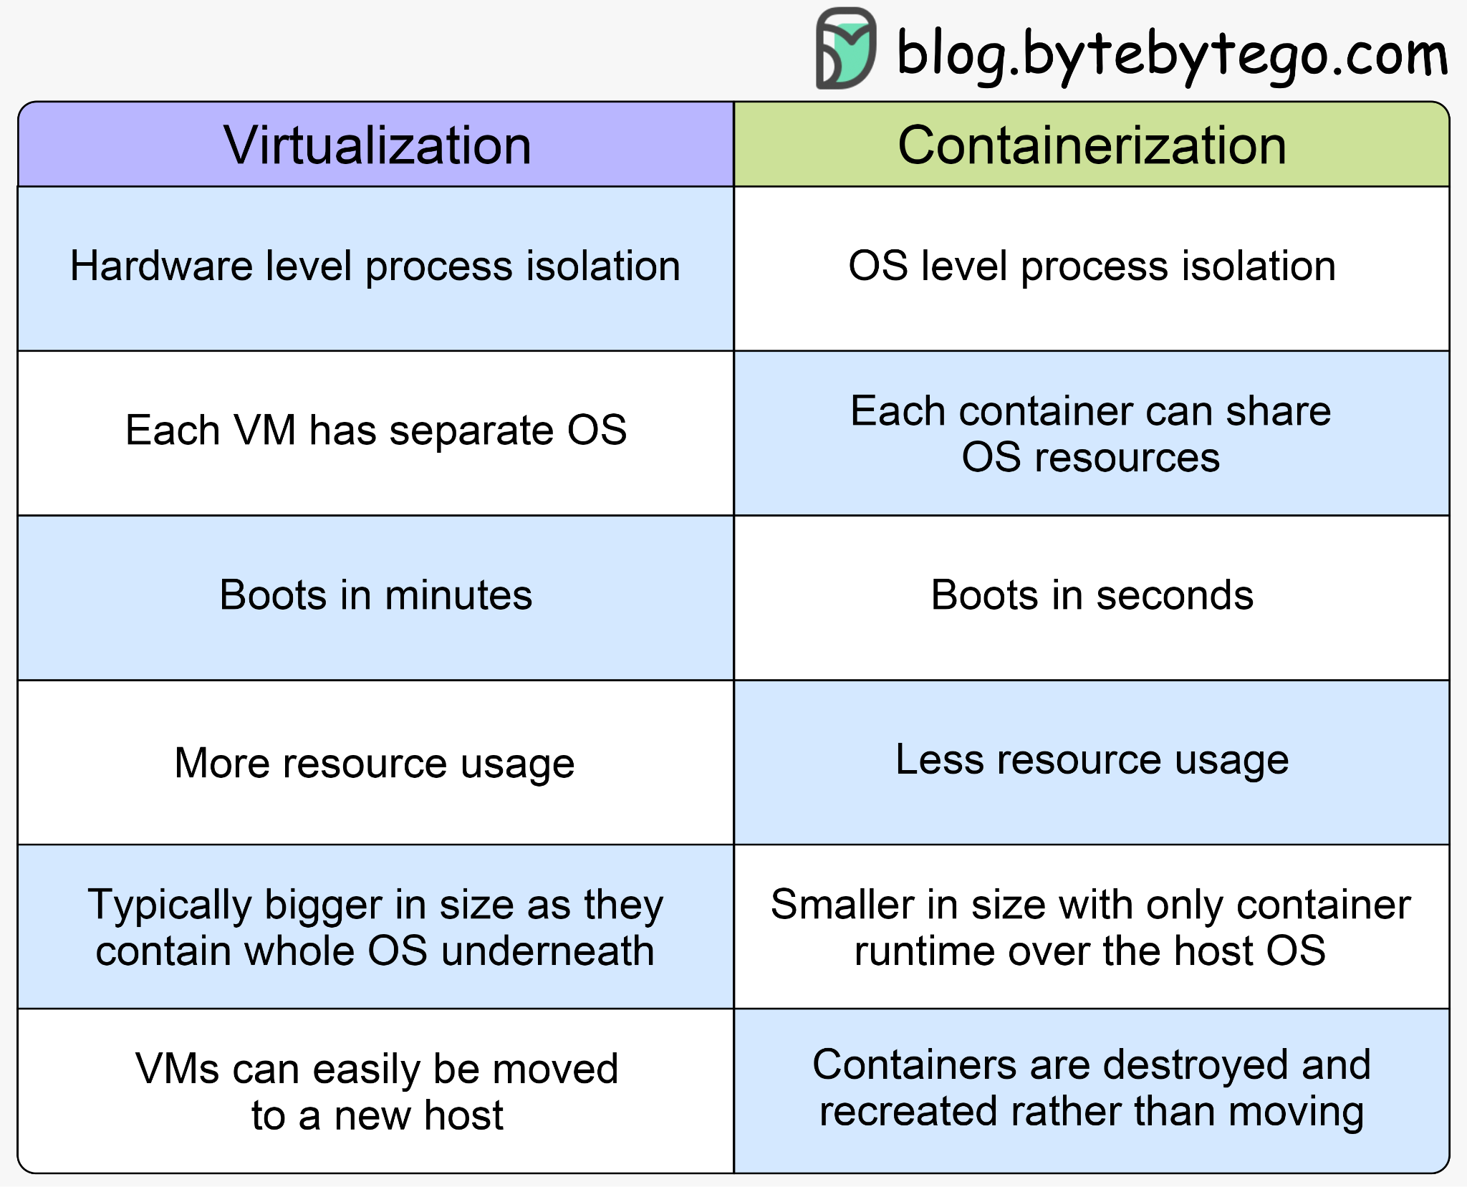
Virtualization and Containerization

Slide 8
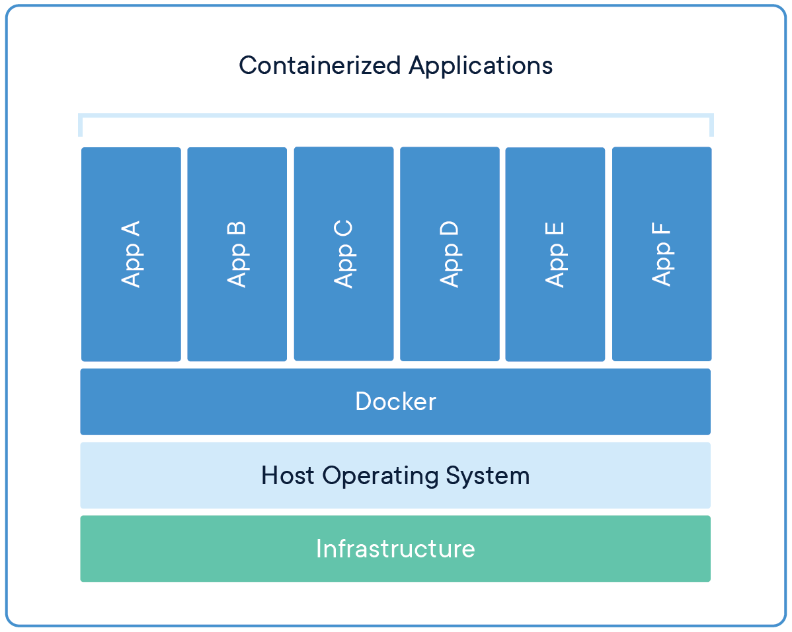
How Containers Work
Core Components:
Container Engine: Manages and runs containers (e.g., Docker Engine).
Container Image: A lightweight, standalone executable package containing everything needed to run an application.
Orchestration Tools: Manage large-scale container deployments (e.g., Kubernetes).
Comparison with Virtual Machines:
Containers share the host OS kernel, while VMs include a full OS.
Containers are faster and more efficient.

Slide 9
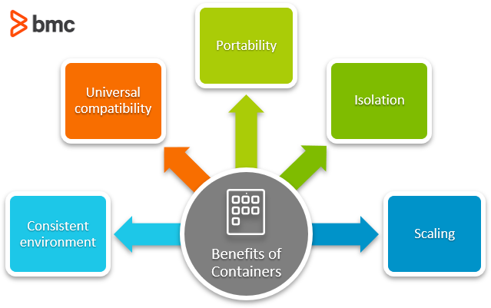
Benefits of Containerization
Portability: Consistent behavior across development, testing, and production environments.
Efficiency: Uses fewer resources than traditional VMs.
Scalability: Easy to scale applications horizontally.
Isolation: Secure and independent runtime environments.
Rapid Deployment: Faster builds, testing, and deployments.

Slide 10
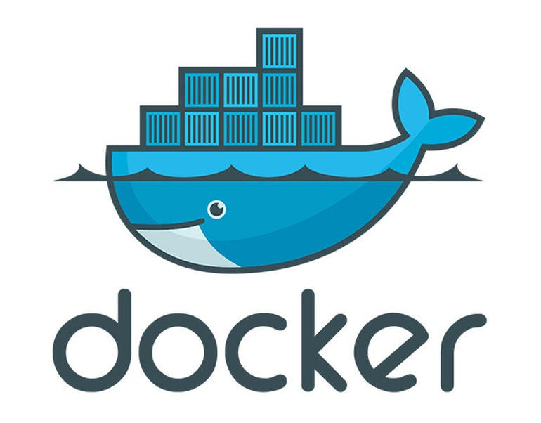
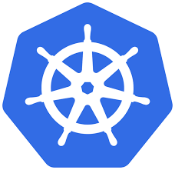
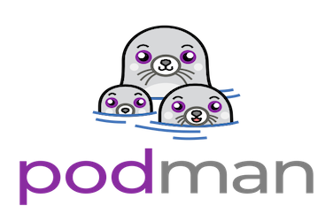
Popular Containerization Tools
Docker:
Most widely used containerization platform.
Easy image creation and management.
Kubernetes:
Orchestrates containerized applications.
Manages scaling, networking, and distribution.
Podman:
Docker-compatible but daemonless.(No BGP)
Focuses on security.

Slide 11
Real-World Use Cases
Microservices Architecture: Breaking monolithic apps into smaller, manageable services.
CI/CD Pipelines: Containerized builds for consistency.
Hybrid Cloud Deployments: Seamlessly migrate workloads between cloud providers.

Slide 12
Challenges of Containerization
Security Concerns: Vulnerabilities in shared host OS.
Learning Curve: Requires understanding of tools like Docker/Kubernetes.
Resource Management: Monitoring and limiting resource use.
Compatibility Issues: Legacy systems may not support containers.

Slide 13
Future of Containerization
Emerging Tools: Alternatives like Podman, CRI-O.
Trends:
Serverless computing leveraging containers.
Edge computing with containerized apps.
Predictions: Greater adoption in IoT and AI workloads.

Slide 14
It Works on my Machine

Slide 15
Summary
Recap of key points:
Lightweight and portable applications.
Key tools: Docker and Kubernetes.
Real-world applications in microservices and CI/CD.

Slide 16
THANK YOU
Amel charoline
Amel Online & Irene magdalena
https://github.com/siagianp
https://www.youtube.com/@AmelOline/videos
https://github.com/amelcharolinesgn2/Cloud-Infrastructures
https://github.com/amelcharolinesgn2/ClouD-Infrastructure-SISKA-2025
https://github.com/amelcharolinesgn2/CCNA1
https://github.com/amelcharolinesgn2/CCNA2
https://github.com/amelcharolinesgn2/AWS Certificate

